Slide 1
Community Integration
Bureau of Recovery Supports
Office of Community Planning and Collaboration

Slide 2



WHO WE ARE
WHO WE SERVE
OUR PRIORITIES
OhioMHAS provides statewide leadership of a high-quality mental health and addiction prevention, treatment, and recovery system that is effective and valued by all Ohioans.
6,000 people in six regional hospitals
17,000 incarcerated men and women
2,000 mental health and addiction services providers
50 ADAMH Boards
Countless individuals across the state
Grow prevention and early intervention efforts
Increase community capacity for clinical care
Improve criminal justice and forensic systems for those with mental illness
Grow recovery supports

Slide 3
Community Integration
Our goal is to support sustainable, person-centered transitions so individuals can live and recover within integrated communities.
Community Integration initiatives facilitate change on a personal and policy level by providing statewide leadership, financial assistance, and empowering individuals to live and recover within their communities.
Recovery Requires a Community
Residential State Supplement (RSS)
RSS Verification Process

Slide 4

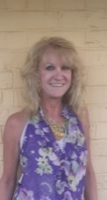



Community Integration Team
Roles & Responsibilities | Status Changes & Technical Assistance | RSS Verification | Policy Work & Other Projects
Information & Referral
Recovery Requires a Community operations | RSS status changes | RSS Verification | Team Leader/ Manager
RSS enrollments | RSS technical assistance | Technical assistance | Statewide policies & initiatives
Statewide policies & initiatives | Statewide policies & initiatives
Megan | Deena |  | Ellie
Administrative support
Barb

Slide 5
Recovery Requires a Community
Helps individuals diagnosed with mental health or substance use disorders by providing financial assistance for transitioning from nursing facilities (nursing homes) to sustainable community living.

Slide 6
Recovery Requires a Community
Eligibility Criteria
Currently receiving treatment in a nursing home and plans to transition to the community OR recently transitioned from a nursing home (within the last 90 days) and is at risk of readmission;
Enrolled in Medicaid;
Has a behavioral health diagnosis (includes mental illness and substance use disorders);
Has sufficient income or the means to sustain community living at time of transition; and
Has needs that can be safely met through the Recovery program or a combination of community resources

Slide 7
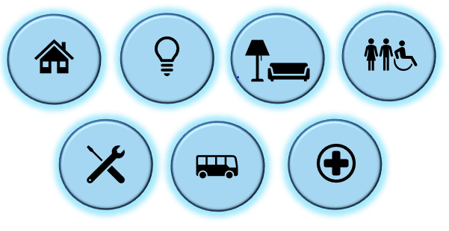
Recovery Requires a Community
Areas of Assistance
Funds can be used in many ways to help individuals transition to the community. Examples include:

Slide 8
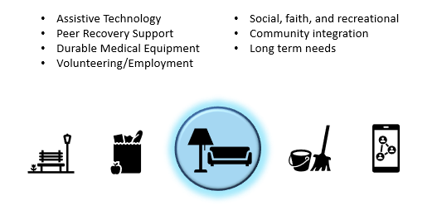
Recovery Requires a Community
Goods and Services Enhancement
Individuals have the option to apply for a standard award of $1,000 for Goods and Services. The funds can be used through the duration of the transition process to purchase items in the Goods and Services category as needs arise.

Slide 9
Recovery Requires a Community Partnerships
Recovery Participant
OhioMHAS
Nursing Facility
State & Local Long Term Care Ombudsman
HOME Choice (ODM & TC Agencies)
Legal Guardian
Community BH Providers
Financial Management Services
Referral Source

Slide 10
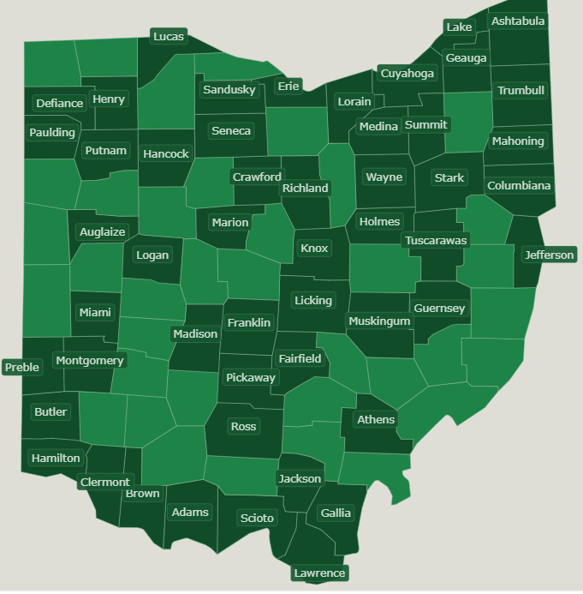
Recovery Requires a Community
Awarded about $610k this fiscal year to over 300 individuals to assist in transitioning back to the community*
About 164 individuals have transitioned successfully in 53 counties across the state from over 200 nursing facilities this fiscal year*
Growing number of providers across the state
Referral sources include nursing facility staff, HOME Choice Transition Coordinators, RF2 operators, family, legal guardians
Participating individuals are linked with a variety of resources and programs upon discharge to the community including but not limited to community behavioral health, peer support, home health waivers, and managed care services
        *as of 11/2023

Slide 11
Residential State Supplement
Provides financial and Medicaid assistance to adults with disabilities who want to live in
eligible living arrangements in the community,
i.e., Class Two Residential Facilities (RF2’s).

Slide 12
Residential State Supplement
Program Changes as of State Fiscal Year (SFY) 2024
Annual Program Budget
  Increased to $24,000,000
Allowable Fee/Rent
  Increased to $1,600 per month
Financial Eligibility
  Monthly income up to $1,800
RSS Benefit Amounts
  Individualized increases per income

Slide 13
Residential State Supplement
Eligibility Criteria
Non-Financial (determined by OhioMHAS)
  Age 18 or older;
  Eligible or enrolled in Medicaid (not a waiver);
  Currently receiving Social Security, SSI, or SSDI;
  Need at least a Protective LOC (presumed if applying from a NF); and
  Residing in Eligible Living Arrangement.
Financial (determined by County Dept of Job & Family Services)
  Monthly income up to $1,800*
  Assets up to $2,000

Slide 14
Residential State Supplement
What is included in the Allowable Fee (“rent”)?
Accommodations: Housing, meals & snacks, laundry, housekeeping, arranging transportation, social & recreational activities, maintenance, security, and similar services
Supervision: Ensuring health, safety, and welfare of residents during Activities of Daily Living (ADL’s) or other activities; reminders of self-care; assisting with making & keeping appointments
Personal Care Services: Assisting with ADL’s and self-administration of medications, preparing special diets

Slide 15
Residential State Supplement
RSS Benefit Amounts – how to calculate
Eligibility Formula |  |  | Benefit Calculation (monthly; ex. SSI)
Rent Amount | $1,600 |  | Monthly Income Limit | $1,800
PNA | $200 |  | SSI | -$943
Monthly Income Limit | $1,800 |  | COLA Disregard | $20
 |  |  | RSS Benefit | $877

Slide 16
Residential State Supplement
Enrollment Process
OhioMHAS
1) Receives RSS application forms & reviews non-financial criteria
2) Refers for LOC (if applicable)
AAA
1) Completes LOC determination with applicant
2) Enters on LTC screen & notifies OhioMHAS
CDJFS
1) Receives referral from OhioMHAS
2) Reviews financial eligibility and authorizes RSS benefits

Slide 17
Residential State Supplement Partnerships
RSS Enrollee
CDJFS
OhioMHAS
Prot Payee (LG, agency)
ODM
Area Agency on Aging
Residential Facility
Authorized Rep
Referral Source
(CM, NF)

Slide 18
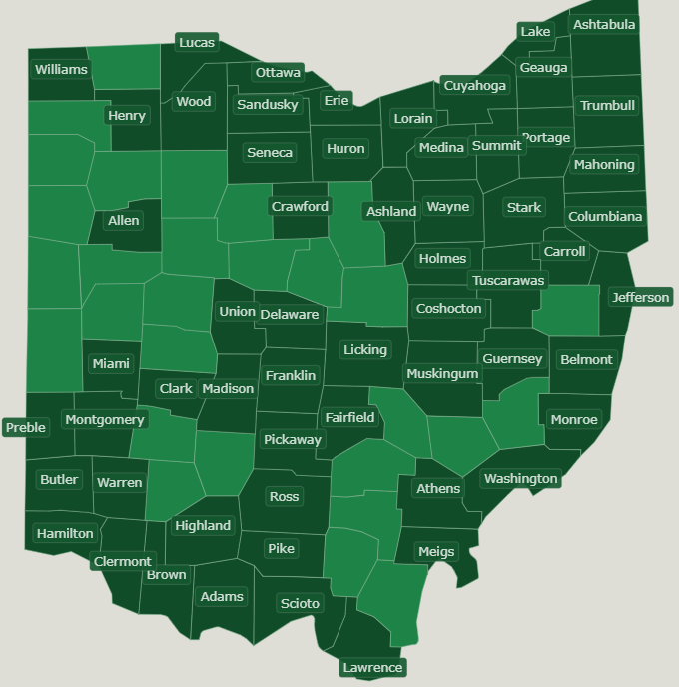
Residential State Supplement
Over 700 applications received this fiscal year from 58 different counties*
Over 2,300 individuals currently enrolled in Class Two Residential Facilities (RF2’s) statewide*
Referral sources include RF2 home operators, case/care managers, regional psychiatric hospitals, diversion centers, crisis stabilization units, legal guardians, peer supporters
*As of 12/2023

Slide 19
RSS Verification Process
Ohio Administrative Code 5122-36-04: Responsibilities of the RSS Living Arrangement
Increases program accountability by verifying RSS enrollees are residing in eligible living arrangements
Operators participate quarterly by completing Living Arrangement Forms (one per facility)

Slide 20
Community Integration
Program Webpages
mha.ohio.gov/get-help/recovery-supports/community-integration
mha.ohio.gov/RRaC
mha.ohio.gov/RSS
OhioMHAS Contact Information
  Recovery Requires a Community Recovery@mha.ohio.gov
    All Recovery operations Megan Boncela (614) 644-0617
  RSS RSS@mha.ohio.gov
    Enrollments Megan Boncela (614) 644-0617
    Status changes, technical assistance Deena Mavromatis (614) 752-9316
  RSS Verification RSSverify@mha.ohio.gov
    All RSS Verification operations
  Community Integration ellie.jazi@mha.ohio.gov
    Questions about programs & policies Ellie Jazi (614) 466-6783

